Slide 1

Mobile Development
Flutter Layout Widgets
Aug 24, 2021
Ariel Cosep,
Application System Engineer
WeServ Systems International, Inc.

Slide 2
Objective
To learn basic knowledge about mobile development using Flutter

Slide 3
Recap
Basic Widgets
MaterialApp
Scaffold
AppBar
Drawer
BottomSheet
BottomNavigationBar
TabBar
Text
etc

Slide 4
Layout Widgets
Center
Container
Padding
Row
Column
Spacer
ListView
Grid
Align
Stack
Expanded
Wrap
Rotate
Etc.

Slide 5
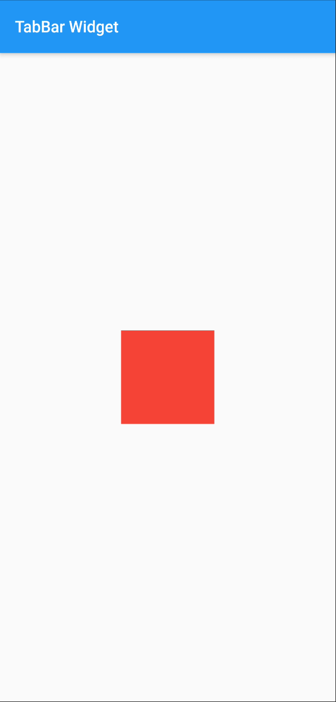
Center
Scaffold(
appBar: AppBar(
title: const Text('TabBar Widget'),
),
body: Center(
child: Container(
height: 100,
width: 100,
color: Colors.red,
),
),
)

Slide 6
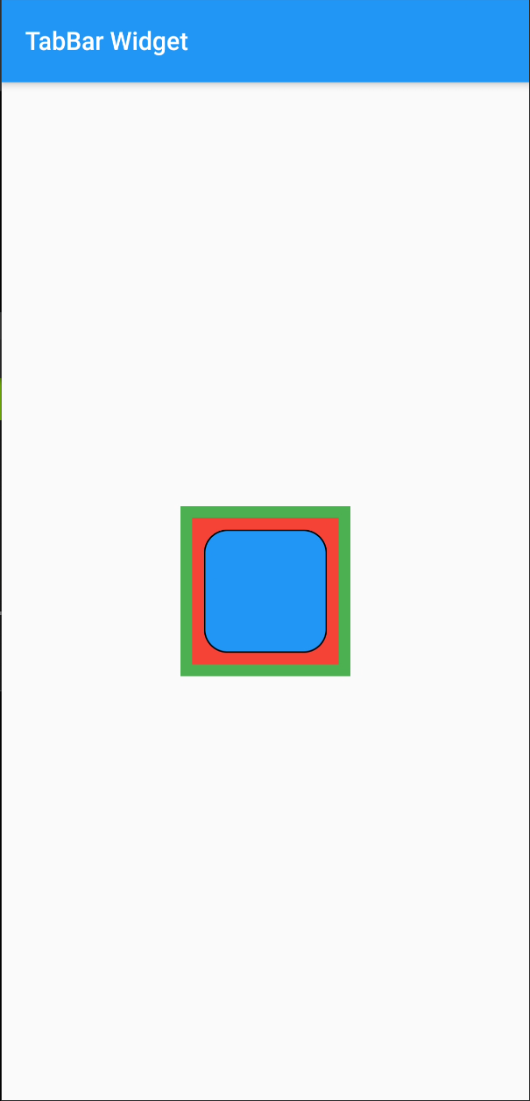
Container
Scaffold(
appBar: AppBar(
title: const Text('TabBar Widget'),
),
body: Center(
child: Container(
color: Colors.green,
child: Container(
height: 100,
width: 100,
padding: const EdgeInsets.all(8.0),
margin: const EdgeInsets.all(8.0),
color: Colors.red,
child: Container(
decoration: BoxDecoration(
color: Colors.blue,
borderRadius: BorderRadius.circular(16.0),
border: Border.all(color: Colors.black),
)
),
),
),
),
)

Slide 7
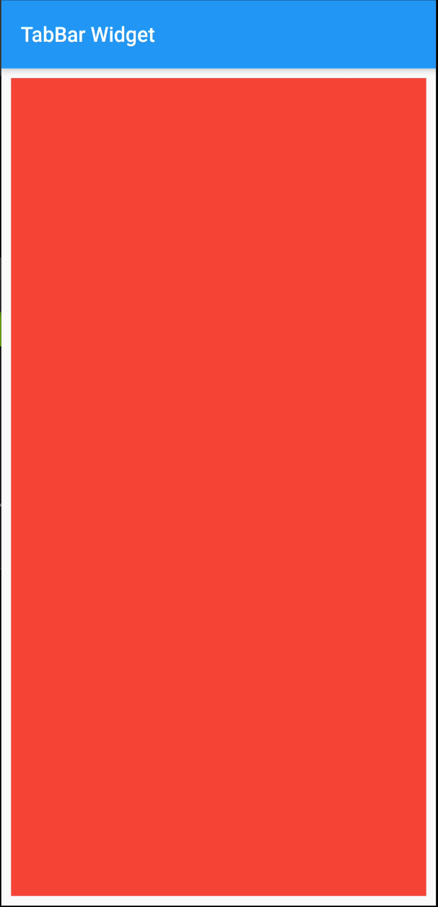
Padding
Scaffold(
appBar: AppBar(
title: const Text('TabBar Widget'),
),
body: Padding(
padding: const EdgeInsets.all(8.0),
child: Container(
color: Colors.red,
),
),
)

Slide 8
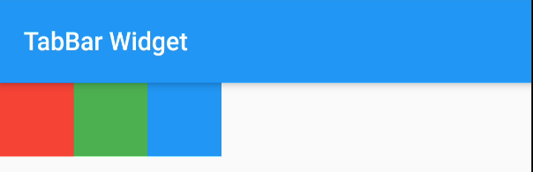
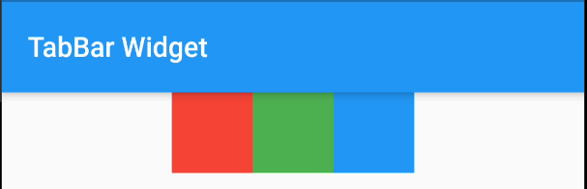
Row
Row(
children: [
(color: Colors.red,height: 50,width: 50,),
Container(color: Colors.green,height: 50,width: 50,),
Container(color: Colors.blue,height: 50,width: 50,)
],
),
Row( mainAxisAlignment: MainAxisAlignment.center,
children: [
Container(color: Colors.red,height: 50,width: 50,),
Container(color: Colors.green,height: 50,width: 50,),
Container(color: Colors.blue,height: 50,width: 50,)
],
),

Slide 9
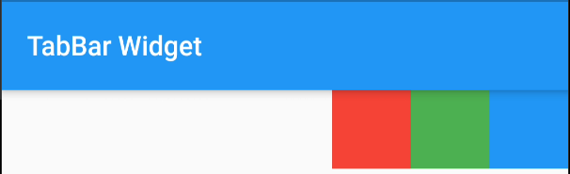
Row: MainAxisAlignment
Row(
mainAxisAlignment: MainAxisAlignment.start,
children: [
Container(color: Colors.red,height: 50,width: 50,),
Container(color: Colors.green,height: 50,width: 50,),
Container(color: Colors.blue,height: 50,width: 50,)
],
),
Row(
mainAxisAlignment: MainAxisAlignment.end,
children: [
Container(color: Colors.red,height: 50,width: 50,),
Container(color: Colors.green,height: 50,width: 50,),
Container(color: Colors.blue,height: 50,width: 50,)
],
),

Slide 10
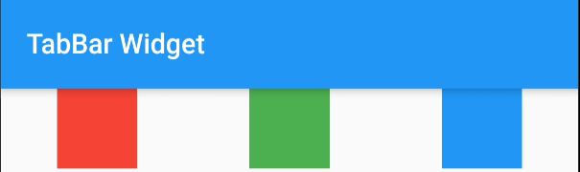
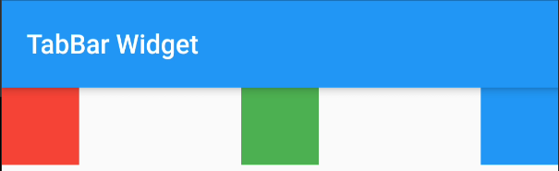
Row: MainAxisAlignment
Row(
mainAxisAlignment: MainAxisAlignment.spaceAround,
children: [],
),
Row(
mainAxisAlignment: MainAxisAlignment.spaceBetween,
children: [],
),
Row(
mainAxisAlignment: MainAxisAlignment.spaceEvenly,
children: [],
),

Slide 11
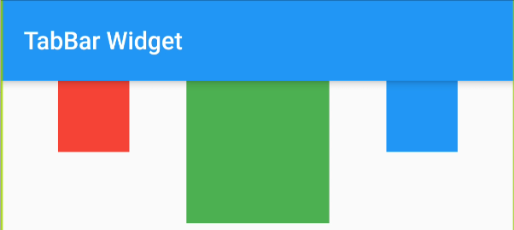
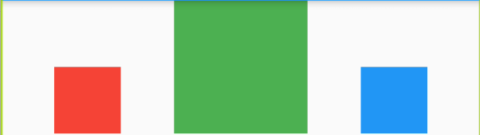
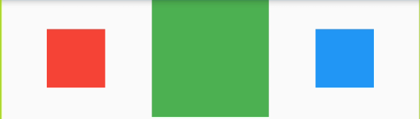
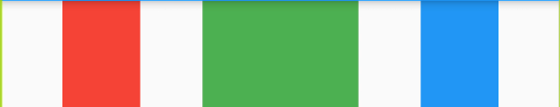
Row: CrossAxisAlignment
Row(
mainAxisAlignment: MainAxisAlignment.spaceEvenly,
crossAxisAlignment: CrossAxisAlignment.start,
children: [
Container(color: Colors.red,height: 50,width: 50,),
Container(color: Colors.green,height: 100,width: 100,),
Container(color: Colors.blue,height: 50,width: 50,)
],
)
CrossAxisAlignment.end
CrossAxisAlignment.center
CrossAxisAlignment.stretch

Slide 12
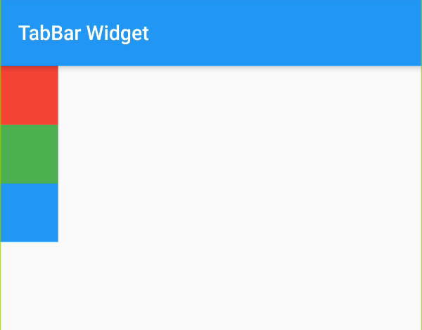
Column
Column(
children: [
Container(color: Colors.red,height: 50,width: 50,),
Container(color: Colors.green,height: 50,width: 50,),
Container(color: Colors.blue,height: 50,width: 50,)
],
)

Slide 13






Column: MainAxisAlignment
Center
Start
End
SpaceEvenly
SpaceBetween
SpaceAround

Slide 14
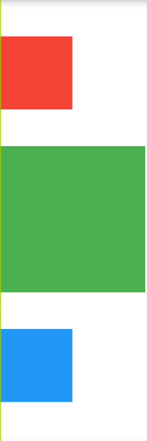
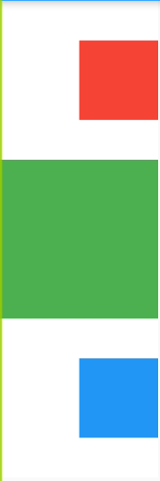
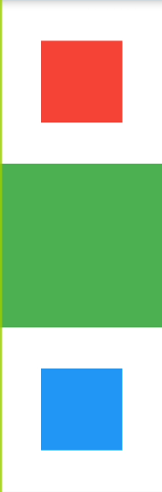
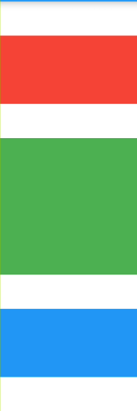
Column: CrossAxisAlignment
Start
End
Center
Stretch

Slide 15


Spacer
Column(
children: [
Container(color: Colors.red,height: 50,width: 50,),
Spacer(),
Container(color: Colors.green,height: 50,width: 50,),
Container(color: Colors.blue,height: 50,width: 50,)
],
)
Column(
children: [
Container(color: Colors.red,height: 50,width: 50,),
Spacer(flex: 1,),
Container(color: Colors.green,height: 50,width: 50,),
Spacer(flex: 2),
Container(color: Colors.blue,height: 50,width: 50,)
],
)

Slide 16
ListView
ListView(
children: [
Container(color: Colors.red,height: 75,),
Container(color: Colors.green,height: 75,),
Container(color: Colors.blue,height: 75,),
Container(color: Colors.orange,height: 75,),
Container(color: Colors.yellow,height: 75,),
Container(color: Colors.black,height: 75,),
],
)

Slide 17
ListView: ScrollDirection Vertical
ListView(
scrollDirection: Axis.horizontal,
children: [
Container(color: Colors.red,width: 75,),
Container(color: Colors.green,width: 75,),
Container(color: Colors.blue,width: 75,),
Container(color: Colors.orange,width: 75,),
Container(color: Colors.yellow,width: 75,),
Container(color: Colors.black,width: 75,),
],
)

Slide 18
Grid
GridView.count(
padding: const EdgeInsets.all(10),
crossAxisSpacing: 5,
mainAxisSpacing: 5,
crossAxisCount: 2,
children: <Widget>[
Container(color: Colors.red),
Container(color: Colors.green),
Container(color: Colors.blue),
Container(color: Colors.orange,),
Container(color: Colors.yellow,),
Container(color: Colors.black,),
],
)

Slide 19
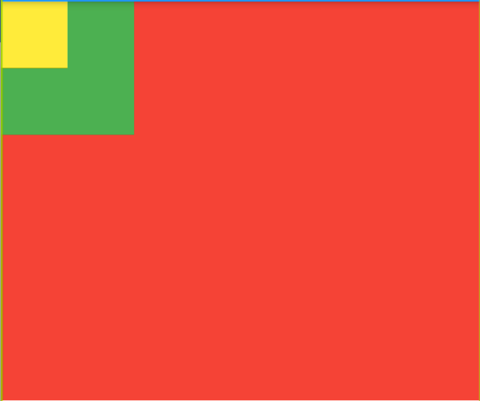
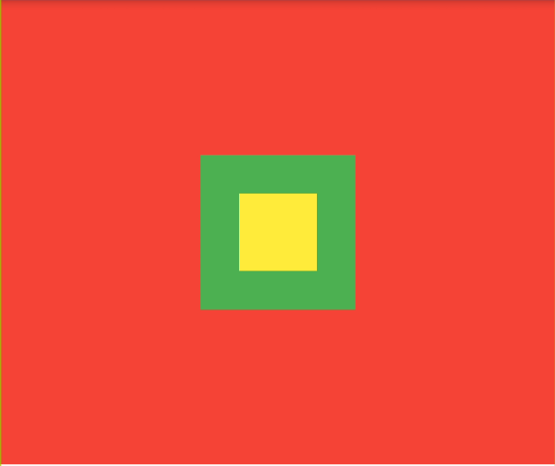
Stack
Stack(
children: [
Container(color: Colors.black,height: 100,width: 100,),
Container(color: Colors.red,),
Container(color: Colors.green,height: 100,width: 100,),
Container(color: Colors.yellow,height: 50,width: 50,)
],
)
Stack(
alignment: Alignment.center,
children: [
Container(color: Colors.black,height: 100,width: 100,),
Container(color: Colors.red,),
Container(color: Colors.green,height: 100,width: 100,),
Container(color: Colors.yellow,height: 50,width: 50,)
],
)

Slide 20
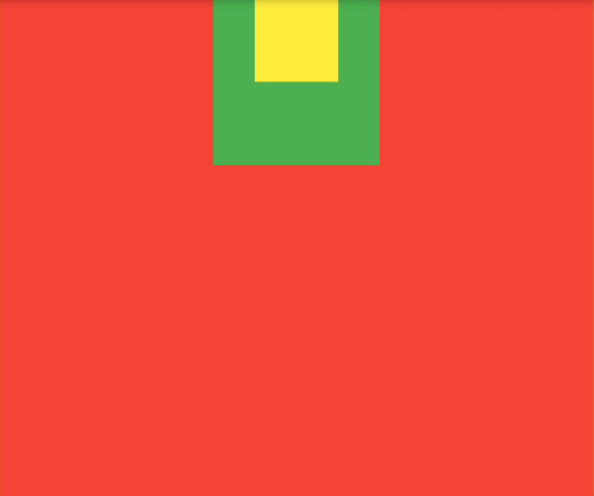
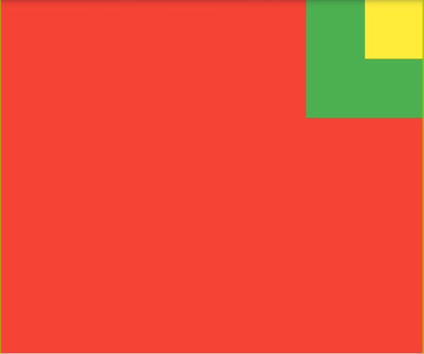
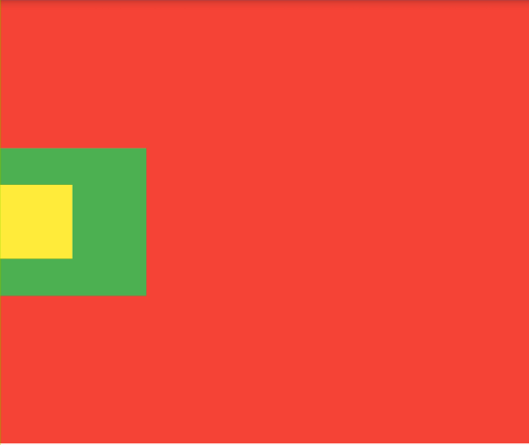
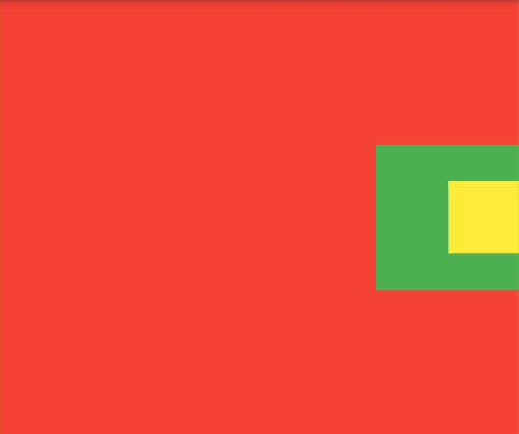
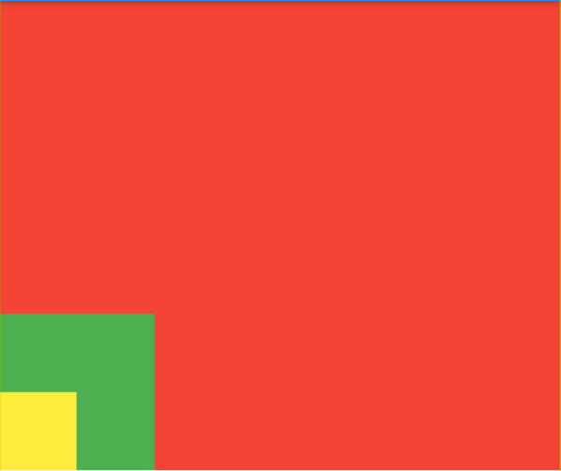
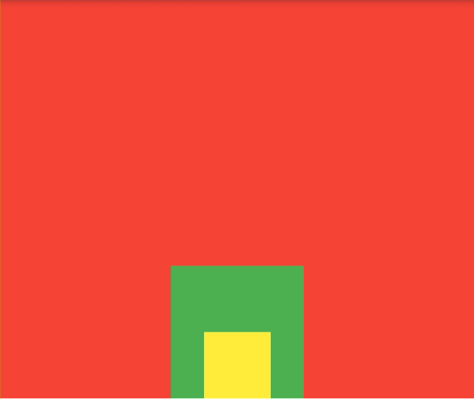
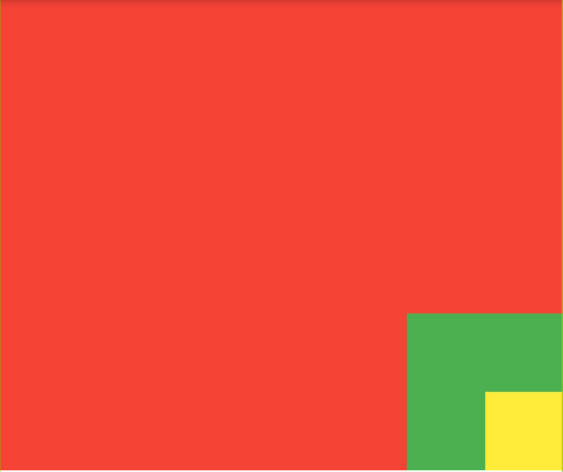
Stack: Alignment
Left
Center
Right
Upper
Center
Bottom

Slide 21
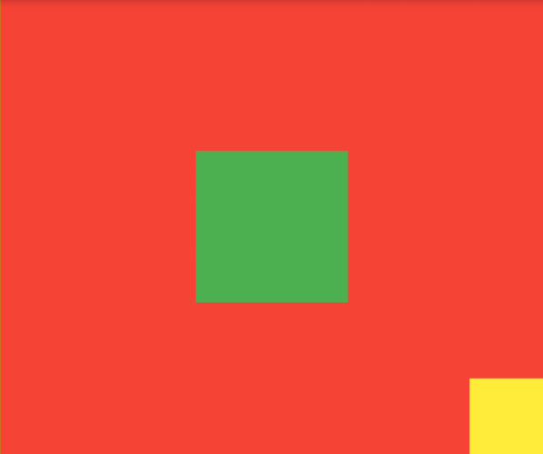
Align
Stack(
children: [
Container(color: Colors.red,),
Align(
alignment: Alignment.center,
child: Container(color: Colors.green,height: 100,width: 100,)
),
Align(
alignment: Alignment.bottomRight,
child: Container(color: Colors.yellow,height: 50,width: 50,)
)
],
)

Slide 22
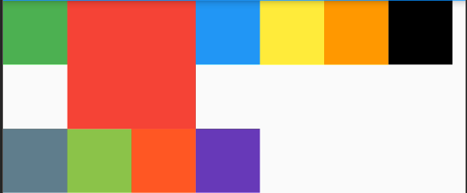
Wrap
Wrap(
children: [
Container(color: Colors.green,height: 50,width: 50,),
Container(color: Colors.red,height: 100,width: 100,),
Container(color: Colors.blue,height: 50,width: 50,),
Container(color: Colors.yellow,height: 50,width: 50,),
Container(color: Colors.orange,height: 50,width: 50,),
Container(color: Colors.black,height: 50,width: 50,),
Container(color: Colors.blueGrey,height: 50,width: 50,),
Container(color: Colors.lightGreen,height: 50,width: 50,),
Container(color: Colors.deepOrange,height: 50,width: 50,),
Container(color: Colors.deepPurple,height: 50,width: 50,),
],
)

Slide 23
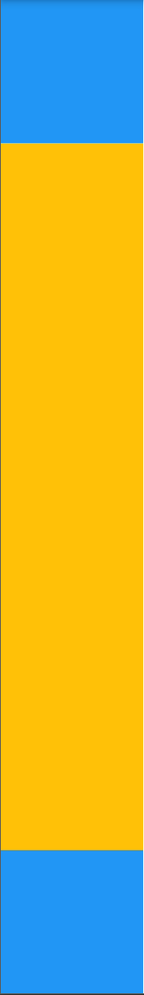
Expand
Column(
children: <Widget>[
Container(
color: Colors.blue,
height: 100,
width: 100,
),
Expanded(
child: Container(
color: Colors.amber,
width: 100,
),
),
Container(
color: Colors.blue,
height: 100,
width: 100,
),
],
)

Slide 24
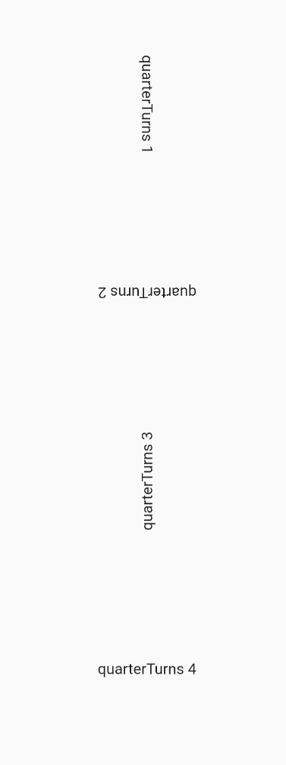
RotatedBox
RotatedBox(
quarterTurns: 1,
child: Text('quarterTurns 1'),
),
RotatedBox(
quarterTurns: 2,
child: Text('quarterTurns 2'),
),
RotatedBox(
quarterTurns: 3,
child: Text('quarterTurns 3'),
),
RotatedBox(
quarterTurns: 4,
child: Text('quarterTurns 4'),
),

Slide 25
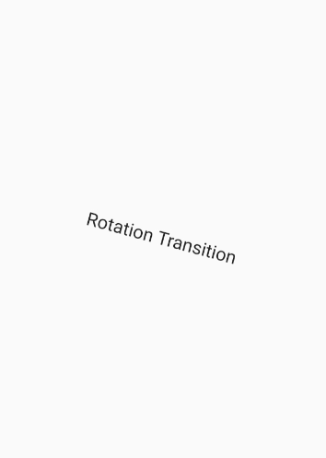
RotationTransform
RotationTransition(
turns: new AlwaysStoppedAnimation(15 / 360),
child: new Text("Rotation Transition"),
)

